Slide 1
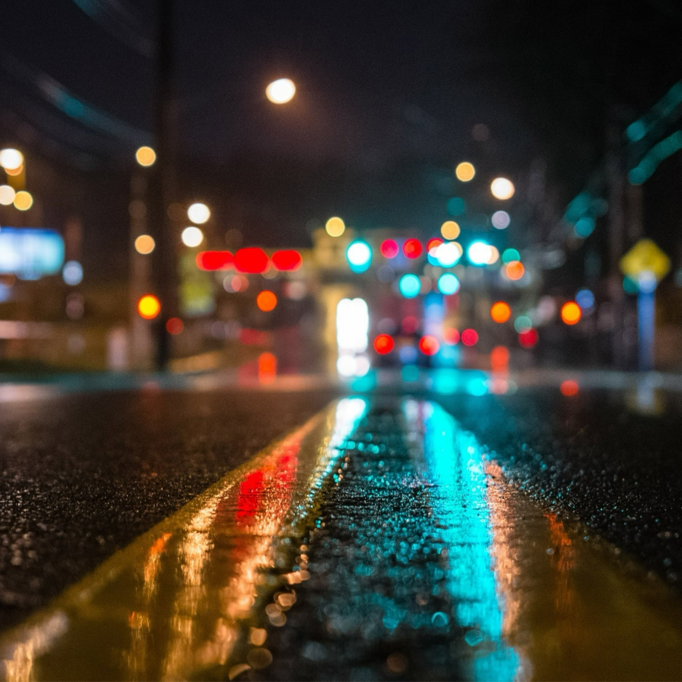
Smart Streetlight System
Group 3
Group 3
03/28/16

Slide 2
Smart Streetlights
Group 3
The Team
Brandon Berry: Electrical Engineering
Anthony Giordano: Electrical Engineering
Thor Cutler: Electrical Engineering
Tucker Russ: Electrical Engineering
Advisors/Mentors
Dr. Jerris Hooker: Project Mentor/Instructor
Dr. Victor DeBrunner: ECE Project Reviewer
Dr. Leonard Tung: ECE Project Reviewer
Dr. Michael Devine: Project Mentor/Entrepreneurial Advisor

Slide 3
Problem (Current Scenario)
Group 3
When a streetlight loses power, the only way that the outage is noticed by the power company is if a customer calls in to report the outage and its location

Slide 4
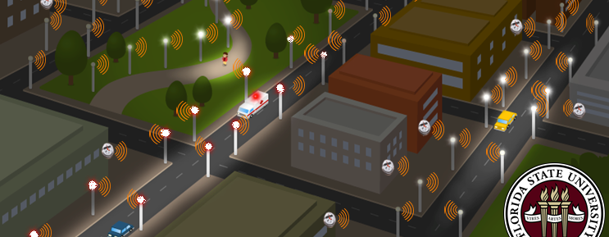
Solution
Group 3
Smart Streetlight System

Slide 5
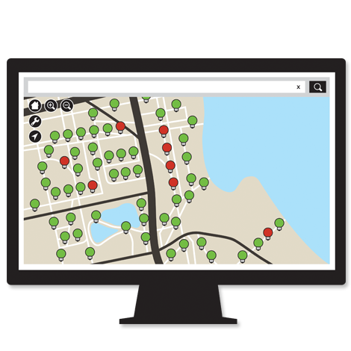
Solution
Group 3
We are designing a device to be installed into streetlights with the following properties:
Wirelessly transmit status to centralized location
Notifies centralized location whether or a light has power or its bulb has blown
Stays powered even if streetlight loses power

Slide 6
Target Market
Group 3
Established Lighting Manufacturers
Lighting Consumers

Slide 7
Potential Lighting Manufacturers
Group 3
Sports Lighting
Streetlights
Parking Lot Lighting

Slide 8
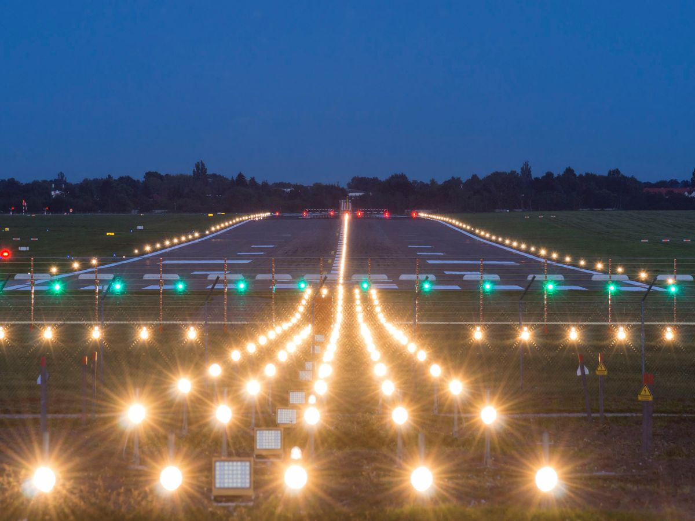
Potential Consumers
Group 3
College campuses
Walkway lights
Highway toll roads
Street lights
Recreational sports complexes
Field lights
Airports
Runway lights
Convenience Stores
Parking lot lights

Slide 9
Prototype Costs
Group 3
Individual Device
Wireless Transmitter- $40
Circuit Board - $4
Wires - $2
Battery - $20
Voltage Controller - $2
Total = $68

Slide 10
Competitors Vs. SSL
Group 3
General Electric’s LightGrid
Smart Streetlight System
Multiple wireless features to monitor and control lights
Requires internet access
Addition software license costs
Single wireless feature to check status of lights
Secure network with no internet required
One time purchase (no contract)

Slide 11
Competitive Advantage
Group 3
Simple solution for monitoring the status of each individual streetlight
Cost efficient alternative to replacing full streetlight
Does not require internet connection

Slide 12
Start-up
Group 3
Partners for testing: Florida State University
Manufacture initial prototypes
Copyright the SSL software

Slide 13
Questions?
Group 3

